Slide 1
WEB TECHNOLOGY I
PREPARED BY:
TIKA RAM KHOJWAR
SCHOOL OF ENVIRONMENTAL SCIENCE AND MANAGEMENT
khojwartikaram@gmail.com

Slide 2
CHAPTER 2
HTML and Graphics

Slide 3
OVERVIEW
▶ Chapter 2 (HTML and Graphics)
▶ Introduction to HTML
▶ HTML Basics
▶ Links and Navigation
▶ Images, Audio and Video
▶ Tables
▶ Form
▶ Frames
▶ Exploring new elements of HTML 5

Slide 4
Introduction to HTML
HTML stands for Hyper Text Markup Language
HTML is the standard markup language for creating Web pages
HTML describes the structure of a Web page
HTML consists of a series of elements
HTML elements tell the browser how to display the content
HTML elements label pieces of content such as "this is a heading", "this is a paragraph", "this is a link", etc.
Browsers do not display the HTML tags, but use them to render the content of the page

Slide 5
Example:
<!DOCTYPE html>
<html>
<head>
<title>Page Title</title>
</head>
<body>
<h1>My First Heading</h1>
<p>My first paragraph.</p>
</body>
</html>

Slide 6
Example Explained
The <!DOCTYPE html> declaration defines that this document is an HTML5 document
The <html> element is the root element of an HTML page
The <head> element contains meta information about the HTML page
The <title> element specifies a title for the HTML page (which is shown in the browser's title bar or in the page's tab)
The <body> element defines the document's body, and is a container for all the visible contents, such as headings, paragraphs, images, hyperlinks, tables, lists, etc.
The <h1> element defines a large heading
The <p> element defines a paragraph

Slide 7
<! DOCTYPE>
On the HTML document there is a <!DOCTYPE html> declaration before the <html> tag.
HTML <!DOCTYPE> tag is used to inform the browser about the version of HTML used in the document.
It is called as the document type declaration (DTD).
Technically <!DOCTYPE > is not a tag/element, it just an instruction to the browser about the document type.
It is a null element which does not contain the closing tag, and must not include any content within it.

Slide 8
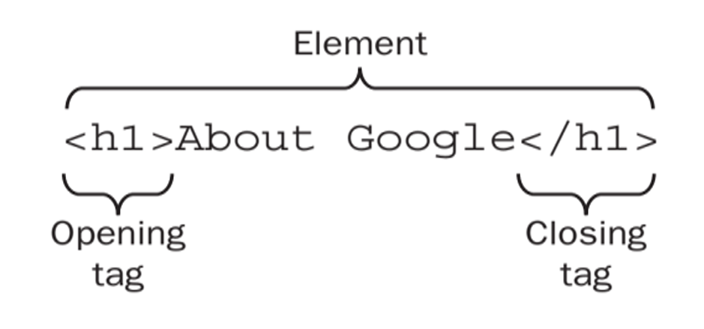
HTML Elements
An HTML element usually consists of a start tag and end tag, with the content inserted in between:
<tagname> Content goes here... </tagname>
e.g.
The HTML element is everything from the start tag to the end tag.
Examples of some HTML elements:
<h1> My First Heading </h1>
<p> My first paragraph. </p>

Slide 9
HTML Elements
HTML elements can be nested. All HTML documents consist of nested HTML elements.
HTML elements with no content are called empty elements.
Eg <br> is an empty element with no closing tag.
Empty elements can be “closed” in the opening tag like <br />
HTML5 does not require empty elements to be closed. But if we want to make our document readable by XML parsers, we must close all HTML elements properly.
HTML tags are not case sensitive.
<P> means the same as <p>

Slide 10
HTML Attributes
HTML attributes are special words which provide additional information about the elements or attributes are the modifier of the HTML element.
Each element or tag can have attributes, which defines the behavior of that element.
Attributes should always be applied with start tag.
The Attribute should always be applied with its name and value pair.
The Attributes name and values are case sensitive, and it is recommended by W3C that it should be written in Lowercase only.

Slide 11
HTML Attributes
We can add multiple attributes in one HTML element, but need to give space between two attributes.
Syntax:
<element attribute_name="value"> Content Here </element>
Example
The href Attribute
<a href="https://www.w3schools.com">This is a link</a>
The src, width and height Attributes
<img src="img_girl.jpg" width="500" height="600">
The title Attribute
<p title="I'm a tooltip"> This is a paragraph. </p>
Notes:
The href Attribute
HTML links are defined with the tag. The link address is specified in the href attribute:
The title Attribute
Here, a title attribute is added to the <p> element. The value of the title attribute will be displayed as a tooltip when you mouse over the paragraph:
The width and height Attributes
Images in HTML have a set of size attributes, which specifies the width and height of the image:

Slide 12
Comment Tag
A comment is a piece of code that is ignored by the web browser.
It is a good practice to add comments into HTML code, especially in complex documents, to indicate sections of document and any other notes to anyone looking at the code.
Comments help us and others understand our code and increase code readability.
Syntax:
<!-- Comments here -->
Notice that there is an exclamation point (!) in the start tag, but not in the end tag
Example:
<!-- This is a comment -->
<p>This is a paragraph.</p>
<!-- Remember to add more information here -->

Slide 13
Meta Tag
HTML <meta> tag is used to represent the metadata about the HTML document.
It specifies page description, keywords, copyright, language, author of the documents, etc.
The metadata does not display on the webpage, but it is used by search engines, browsers and other web services which scan the site or webpage to know about the webpage.
The <meta> tag is placed within the <head> tag, and it can be used more than one times in a document.
Notes:
Metadata = data about data | additional important information about a document in a variety of ways

Slide 14
Meta Tag
<head>
<meta charset=‘UTF-8’>
<meta name=“description” content=“BCA 5th Sem”>
<meta name=“keywords” content=“HTML, CS, XML”>
<meta name=“author” content=“John Smith”>
<meta name=“viewport” content=“width=device-width, initial-scale=1.0”>
</head>

Slide 15
2.2 HTML Basics

Slide 16
Text Formatting
HTML offers various tags to format text. Some common text formatting tags include:
<b> - bold text
<strong> - important text
<i> - italic text
<em> - Emphasized text
<mark> - marked text
<small> - small text
<del> - deleted text
<ins> -> inserted text
<sub> - subscript text
<sup> - superscript text

Slide 17
HTML Headings
HTML headings are titles or subtitles that we want to display on a webpage.
HTML headings are defined with the <h1> to <h6> tags
Syntax:
<heading type> Heading title </heading type>
Example:
<h1>Heading 1</h1>
<h2>Heading 2</h2>
<h3>Heading 3</h3>
<h4>Heading 4</h4>
<h5>Heading 5</h5>
<h6>Heading 6</h6>
Search engines use the headings to index the structure and content of your web pages.
Users often finds a page by its headings.

Slide 18
HTML Paragraph
The HTML <p> element defines a paragraph.
These have both opening and closing tags.
So anything mentioned within <p> and </p> is treated as a paragraph.
A paragraph always starts on a new line.
Syntax:
<paragraph tag> Paragraph content here </paragraph tag>
Example:
<p>This is a paragraph.</p>
<p>This is another paragraph.</p>

Slide 19
Phrase Elements
Phrase elements define the meaning or semantics of text.
<abbr> Indicates an abbreviated form like pvt. inc. etc
<acronym> Indicates an acronym (e.g., WAC, radar, etc.).
<em> Indicates emphasis.
<strong> Indicates stronger emphasis.
<cite> Contains a citation or a reference to other sources.
<dfn> Indicates that this is the defining instance of the enclosed term.
<code> Designates a fragment of computer code.
<samp> Designates sample output from programs, scripts, etc.
<kbd> Indicates text to be entered by the user.
<var> Indicates an instance of a variable or program argument.
Notes:
Acronym (संक्षिप्त) = an abbreviation formed from the initial letters of other words and pronounced as a word (e.g. ASCII, NASA ).
RADAR is Radio Detection And Ranging.
Women's Army Corps (WAC)
<abbr>: Denotes an abbreviation. Eg. <abbr title="Hypertext Markup Language">HTML</abbr>
<cite>: Indicates a citation eg. <cite>The Art of Computer Programming</cite>
<code>: Represents computer code. Eg. <code>print("Hello World!")</code>
<q>: For short inline quotations eg. <q>Inline quote here.</q>

Slide 20
HTML Lists
HTML offers web authors three ways for specifying lists of information.
All lists must contain one or more list elements.
Lists may contain −
<ul> An unordered list. This will list items using plain bullets.
<ol> An ordered list. This will use different schemes of numbers to list your items.
<dl> A definition list. This arranges your items in the same way as they are arranged in a dictionary

Slide 21
HTML Unordered Lists
An unordered list is a collection of related items that have no special order or sequence.
This list is created by using HTML <ul> tag.
Each item in the list is marked with a bullet.
We can use type attribute for <ul> tag to specify the type of bullet we like.
By default, it is a disc.
<ul type=”square”>
<ul type=”disc”>
<ul type=”circle”>

Slide 22
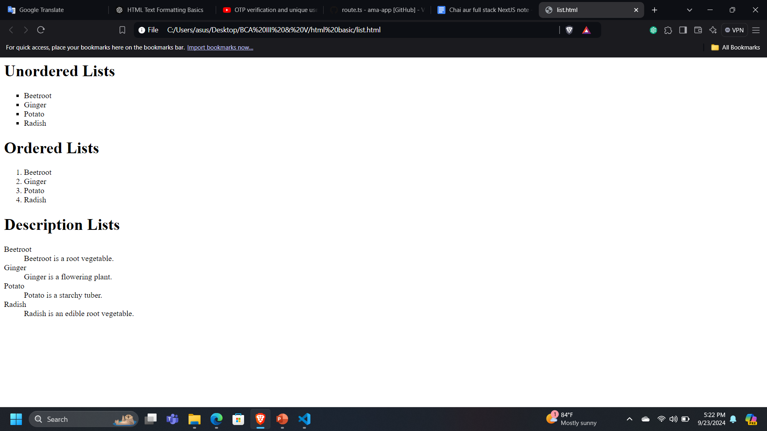
HTML Unordered Lists
Example:
<ul type = "square">
<li>Beetroot</li>
<li>Ginger</li>
<li>Potato</li>
<li>Radish</li>
</ul>
Output:

Slide 23
HTML Ordered Lists
If you are required to put your items in a numbered list instead of bulleted, then HTML ordered list will be used.
This list is created by using <ol> tag.
The numbering starts at one and is incremented by one for each successive ordered list element tagged with .
You can use type attribute for <ol> tag to specify the type of numbering you like.
By default, it is a number.
Following are the possible options −
<ol type = "1"> - Default-Case Numerals.
<ol type = "I"> - Upper-Case Numerals.
<ol type = "i"> - Lower-Case Numerals.
<ol type = "A"> - Upper-Case Letters.
<ol type = "a"> - Lower-Case Letters.

Slide 24
HTML ordered Lists
Example:
<ol type = "1">
<li>Beetroot</li>
<li>Ginger</li>
<li>Potato</li>
<li>Radish</li>
</ol>
Output:

Slide 25
HTML Definition Lists
HTML and XHTML supports a list style which is called definition lists where entries are listed like in a dictionary or encyclopedia.
The definition list is the ideal way to present a glossary, list of terms, or other name/value list.
Definition List makes use of following three tags.
<dl> − Defines the start of the list
<dt> − A term
<dd> − Term definition
</dl> − Defines the end of the list
Notes:
(XHTML stands for EXtensible HyperText Markup Language. It is the next step to evolution of internet. The XHTML was developed by World Wide Web Consortium (W3C). It helps web developers to make the transition from HTML to XML)

Slide 26
HTML Definition Lists
Example:
<dl>
<dt>Beetroot</dt>
<dd>Beetroot is a root vegetable.</dd>
<dt>Ginger</dt>
<dd>Ginger is a flowering plant.</dd>
<dt>Potato</dt>
<dd>Potato is a starchy tuber.</dd>
<dt>Radish</dt>
<dd>Radish is an edible root vegetable.</dd>
</dl>
Output:

Slide 27
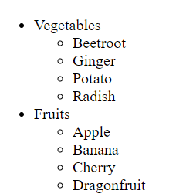
Nested Lists
HTML nested lists simply mean a list inside another list.
It can be an unordered list or an ordered list.
<div>
<h1>Nested Lists</h1>
<ul>
<li>Vegetables
<ul>
<li>Beetroot</li>
<li>Ginger</li>
<li>Potato</li>
<li>Radish</li>
</ul>
</li>
<li>Fruits
<ul>
<li>Apple</li>
<li>Banana</li>
<li>Cherry</li>
<li>Dragonfruit</li>
</ul>
</li>
</ul>
</div>
Output:

Slide 28
Character entities for Special Character
Special characters are typically those that can't be easily typed into a keyboard or may cause display issues if typed or pasted into a web page.
To display special characters (such as symbols) in HTML, you use character entities:
&lt; : <
&gt; : >
&amp; : &
&quot; : "
&apos; : '
&copy; : ©
Example:
<p>This is a greater than symbol: &gt;</p>

Slide 29
<font> Element and Attributes
The <font> element was traditionally used to change text color, size, and font family.
However, it's deprecated in HTML5, and modern CSS should be used instead.
Attributes:
color: Defines the color of the text.
size: Specifies the size of the text.
face: Specifies the font family.
Example of the outdated usage of the <font> element:
<font color="red" size="4" face="Arial">This is old-fashioned formatting.</font>
However, it’s better to use CSS for text formatting today:
<p style="color: red; font-size: 16px; font-family: Arial;">This is modern formatting.</p>

Slide 30
Day 4

Slide 31
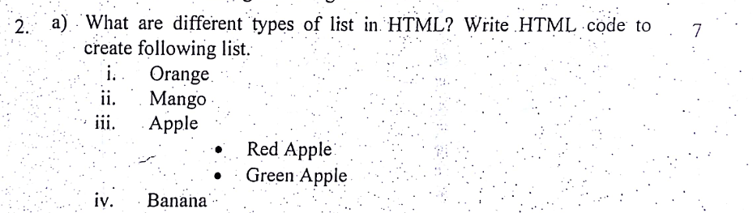
Classwork

Slide 32
Grouping Elements
Grouping our HTML content in containers makes it easier for us to target our elements with class and id selectors.
This, in turn, makes it easier for us to position and style HTML via CSS.
Generally, two tags <div> and <span> are used for grouping different elements.

Slide 33
Grouping Elements
<div> tag:
A very block level tag which groups various HTML tags and applying CSS to group of elements
Event used to create webpage layout.
This tag does not provide any visual change on the block but this has more meaning when it is used with CSS.

Slide 34
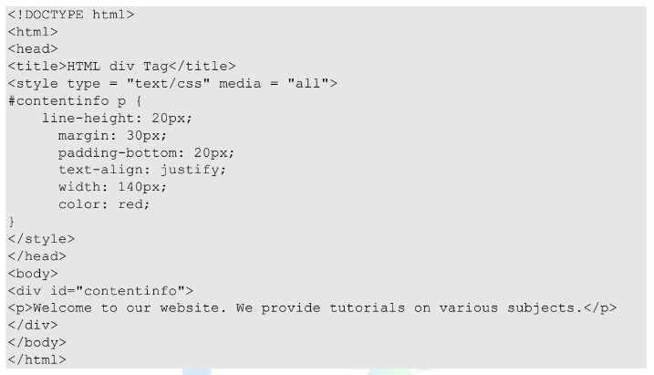
Grouping Elements

Slide 35
Grouping Elements
<span> tag:
Span is an inline element and can be used to group inline elements in an HTML document.
Main difference between the span tag and div tag is that
span tag is used with inline elements whereas
the div tag is used with block level elements

Slide 36
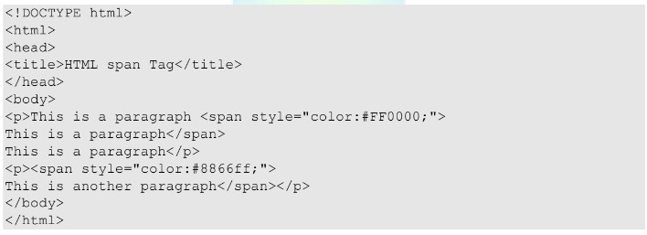
Grouping Elements

Slide 37
Difference between <div> and <span> tag
<div> | <span>
Div is a block level element | Span is an inline element
If we need to modify a large division, the height, move an element, or contain other elements we could use a <div> | If we want to adjust a small portion of text and not break it out of the current line, we should use <span>
Example: <div style=“width: 200px; background- color: #ececec; padding: 10px”> <p> this is example of div tag </p> </div> | Example <p> This text is <span style=“color:red”> red text </span></p>

Slide 38
Block Elements
They appear on the screen as if they have a line break before and after them.
Eg <p></p>, <h1></h1>,<ul></ul>, <ol></ol>.
They start on their own new line and anything that follows them appears on its own new line.

Slide 39
Inline Elements
They appear within sentence and do not have to appear on a new line of their own.
Eg <b>, <i>, <u>,<sup>,<big>, <small>, <li>

Slide 40
2.3 Links and Navigation
HTML links are hyperlinks.
We can click on a link and jump to another document.
A link does not have to be text.
A link can be an image or any other HTML element.
The HTML <a> tag defines a hyperlink.
It has the following syntax:
<a href="url" attribute-lists>link text</a>

Slide 41
2.3.1 Linking To other web pages
Link is simply defined as an element, which is clickable, so it helps to move from one page to another whenever this element has been clicked.
The most important attribute of the <a> element is the href attribute, which indicates the link's destination.
The link text is the part that will be visible to the reader.
Clicking on the link text, will send the reader to the specified URL address.
Syntax:
<a href="url">link text</a>
Example:
<a href="https://www.facebook.com">Click this link to go to facebook</a>

Slide 42
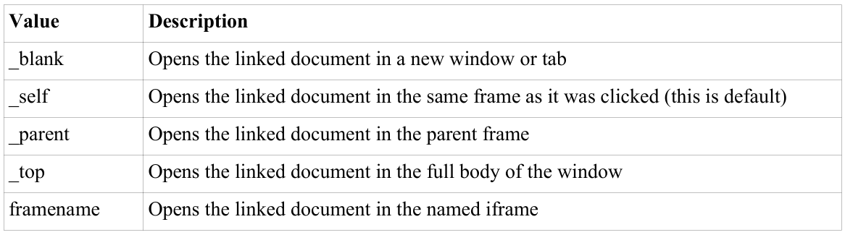
Target Attribute:
The target attribute specifies where to open the linked document.
Syntax:
<a target="_blank|_self|_parent|_top|framename">

Slide 43
Linking to email
HTML <a> tag provides us option to specify an email address to send an email.
While using <a> tag as an email tag, we will use mailto: email address along with href attribute.
Following is the syntax of using mailto instead of using http.
<a href = "mailto: email-address">Email Text</a>
Example:
<a href = "mailto: khojwartikaram@gmail.com">Click here to email me</a>
Notes:
Now, if a user clicks this link, it launches one Email Client (like Mozilla thunderbird, Outlook Express etc. ) installed on user's computer. There is another risk to use this option to send email because if user do not have email client installed on their computer then it would not be possible to send email.

Slide 44
Default Settings
We can specify a default email subject and email body along with email address.
Following is the example to use default subject and body.
<a href = "mailto:khojwartikarm?subject = Feedback&body = Message">Send Email</a>

Slide 45
Understanding Directories and Directories structure
A file path describes the location of a file in a web site's folder structure.
Its like an address of a file which helps the web browser to access the files.
File paths are used to link external resources such as images, videos, style sheets, JavaScript, displaying other web pages etc.
To insert a file in a web page its source must be known. For example,
the syntax (<img src=” ” >) is used to insert an image file, where the path of the file is mentioned in the source (src).

Slide 46
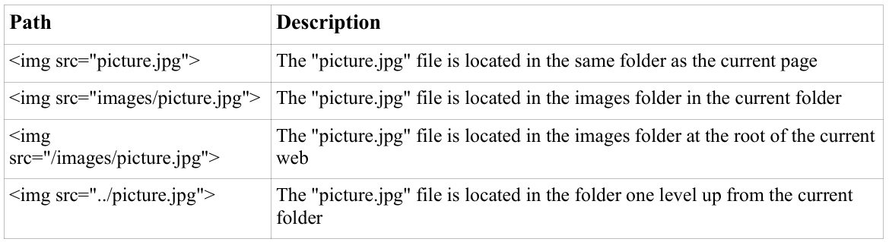

Slide 47
File paths are of two types:
Absolute File Paths
Relative File Paths

Slide 48
Absolute File Paths:
It describes the full address(URL) to access an internet file.
Example:
<!DOCTYPE html>
<html>
<head>
<title>Absolute file path</title>
</head>
<body>
<img src="https://www.schems.edu.np/themes/schems/images/logo.png" alt="logo" title="SchEMS">
</body>
</html>

Slide 49
Relative File Path
It describes the path of the file relative to the location of the current web page file.
Below Example shows the path of the file present
in the same folder of the current web page file.
<img src=”logo1.jpeg” alt=”logo” title=”NCIT”>
in the img folder in the the current folder where web page file exists.
<img src=”img/logo2.jpeg” alt=”logo” title=”NCIT”>
in the a folder one level above current web page file.
<img src=”../images/logo.png” alt=”logo” title=”NCIT”>
in the images folder located at the root of the current web:
<img src=”/images/logo.png” alt=”logo” title=”NCIT”>

Slide 50
Day 5

Slide 51
2.4 Images, Audio and Video

Slide 52
Inserting an image
The HTML <img> tag is used to embed an image in a web page.
Images are not technically inserted into a web page; images are linked to web pages.
The <img> tag creates a holding space for the referenced image.
The <img> tag is empty, it contains attributes only, and does not have a closing tag.
The <img> tag has two required attributes:
src - Specifies the path to the image
alt - Specifies an alternate text for the image
Syntax:
<img src="url" alt="alternatetext">
Example:
<img src=”img/logo2.jpeg” alt=”logo” title=”SchEMS Logo”>
Notes:
The src Attribute : The required src attribute specifies the path (URL) to the image.
The alt Attribute : The required alt attribute provides an alternate text for an image, if the user for some reason cannot view it (because of slow connection, an error in the src attribute, or if the user uses a screen reader). The value of the alt attribute should describe the image:

Slide 53
Image as a Link
We can add image as a link (other HTML elements can also be used as a link).
A link is a connection from one Web page to another web page.
The <a> tag defines a hyperlink and used to link from one page to another.
The href attribute is used with the <a> tag, which indicates the link's destination.
To use image as a link, we just need to use image inside the hyperlink at the place of text as shown in below example.
Syntax:
<a href="link address" attribute-lists><img src=”image-link”></a>
Example:
<a href="https://www.facebook.com"><img src=”facebook-logo.jpeg” alt=”facebook logo”></a>

Slide 54
Image Maps
An image map is an image with clickable areas.
Image maps are images that provide multiple active regions that users can activate to navigate.
The HTML <map> tag defines an image map.
An image map is an image with clickable areas. The areas are defined with one or more <area> tags.
Try to click on the computer, phone, or the cup of coffee in the image of below example:

Slide 55
Client-side image maps
Client-side image maps in HTML allow you to define clickable areas on an image that can link to different URLs or perform specific actions.
Here’s a quick guide on how to create one:
Define the Image: Use the <img> tag with the usemap attribute, which links to a map of clickable areas.
Create the Map: Use the <map> tag with the name attribute to define the clickable regions. Inside, specify clickable areas with the <area> tag.
Specify Areas: The <area> tag has attributes for defining the shape (rect, circle, or poly), coordinates (coords), and link (href).

Slide 56
Example:
<!DOCTYPE html>
<html>
<body>
<h2>Image Maps</h2>
<p>Click on the computer, the phone, or the cup of coffee to go to a new page and read more about the topic:</p>
<img src="imagemaps/workplace.jpeg" alt="Workplace" usemap="#workmap" width="400" height="379">
<map name="workmap">
<area shape="rect" coords="34,44,270,350" alt="HTML hidden fields" href="2.6.8-hidden-field.html">
<area shape="rect" coords="290,172,333,250" alt="html relative path" href="2.3.9-relative-paths.html">
<area shape="circle" coords="337,300,44" alt="Cup of coffee" href="2.3.9-relative-paths.html">
</map>
</body>
</html>

Slide 57
Server-side image maps
Server-side image maps let a server handle the clickable areas in an image rather than handling them entirely on the client side.
When a user clicks on a specific area of the image, the coordinates of the click are sent to the server, which can then determine which part of the image was clicked and respond accordingly.

Slide 58
To create a basic server-side image map:
Define the Image with ismap: Use the <img> tag with the ismap attribute, which enables server-side mapping. Also, include the href attribute in a surrounding <a> tag to specify the server-side script that will process the click.
Set up Server-Side Script: The script (e.g., PHP, ASP.NET) will receive x and y coordinates of the click and can respond based on which part of the image was clicked.

Slide 59
Example:
<a href="/action_page.php" target=”_self”>
<img src="imagemaps/workplace.jpeg" alt="server side image maps" ismap>
</a>
NOTE: The is map attribute is allowed only if the <img> element is a descendant of an <a> element with a valid href attribute.
Notes:
Example Server-Side Script (PHP) <?php
$x = $_GET['x'];
$y = $_GET['y'];
// Determine which area was clicked based on coordinates
if ($x >= 34 && $x <= 270 && $y >= 44 && $y <= 350) {
echo "You clicked the rectangle!";
} elseif (pow(($x - 337), 2) + pow(($y - 300), 2) <= pow(44, 2)) {
echo "You clicked the circle!";
} else {
echo "You clicked an unassigned area.";
}
?>
How It Works
Click Coordinates: When the user clicks, the ismap attribute causes the browser to send the x and y coordinates to the server as query parameters (?x=xx&y=yy).
Coordinate Handling: The server-side script checks these coordinates against predefined areas and generates a response accordingly.

Slide 60
HTML <area> coords Attribute
Use the coords attribute to specify the coordinates of each area in the image map.
This attribute is used together with the shape attribute to specify the size, shape, and placement of an area.
Syntax
<area coords="value">
Example:
<map name="planetmap">
<area shape="rect" coords="0,0,82,126" href="sun.htm" alt="Sun">
<area shape="circle" coords="90,58,3" href="mercur.htm" alt="Mercury">
<area shape="circle" coords="124,58,8" href="venus.htm" alt="Venus">
</map>

Slide 61
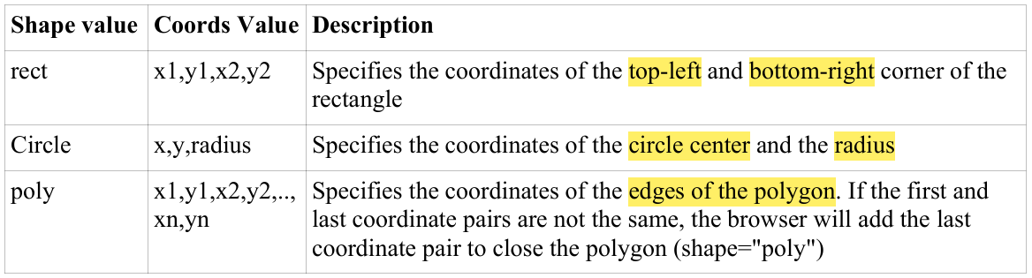
Attribute Values of shape and coords

Slide 62
Day 6

Slide 63
2.4.2 Choosing the right image format
Image formats are divided into two main categories:
raster files and
vector files.
Each category has its own intended use.

Slide 64
Vector graphics
Vector graphics use lines, points and polygons to represent an image.
They are best suited for simple geometric shapes and work great for logos and icons.
Vectors can be infinitely scaled without losing quality, making them ideal for high-resolution screens and varying sizes.
However, vectors are not the best file format to save photos.
Vector file formats: SVG, PDF, EPS, AI

Slide 65
Raster graphics
Raster graphics use pixel values within a rectangular grid to represent an image.
They are best suited for complex images such as photographs.
Unlike vectors, these file types are resolution-dependent and based on their size, meaning they can’t be scaled up without losing quality and becoming pixelated.
The majority of images online are in raster format.
Raster file formats: JPEG, PNG, GIF, TIFF, PSD

Slide 66
Image Format
▶ Each image tag has its own pros and cons.
▶ Each format is created for specific, yet different purposes.
▶ a. JPEG
▶ Short for Joint Photographic Experts Group
▶ JPEG files are very ‘lossy’, as so much information is lost from the original file.
▶ Reason: To keep the image file size small
▶ JPEG is very web-friendly because of smaller file size and requires less time to transfer to a site.

Slide 67
Image Format
▶ Pros and Cons of JPEG
PROS | CONS
24-bit color, with up to 16 million colors | They tend to discard a lot of data
Rich colors, greater for photographs, that need fine attention | After compression, JPEG tends to create Artifacts
Most used and most widely accepted image format | Can not be animated
Compatible in most OS | Does not support transparency.

Slide 68
Image Format
▶ b. GIF
▶ Short for Graphics Interchange Format
▶ Limited to 8-bit palette with only 256 colors
▶ Popular image format on the internet because of relatively small size.
▶ Most suitable for graphics, diagrams, cartoons and logos
▶ Mostly chosen format for animation effects.
▶ GIF is lossless for images with 256 colors and below. For a full color image, it may lose up to 99.998% of its colors
▶ GIF has interlacing feature, giving the illusion of fast loading graphics.

Slide 69
Image Format
▶ Pros and Cons of GIF
PROS | CONS
Can support transparency | Only supports 256 colors
Can do small animation effects | Oldest format on web.
Lossless quality for image with 256 colors
Great for images with limited colors

Slide 70
Image Format
▶ C. BMP
▶ Windows Bitmap or BMP files are image files within the Windows operating system.
▶ Files are large and uncompressed but images are rich in color, high in quality, simple and compatible for all windows OS and programs
▶ Also called raster or paint images
▶ BMP files are made of millions and millions of dots called pixels, with different color and arrangements to come up with an image or pattern.
▶ It might be an 8-bit, 16-bit or 24-bit image

Slide 71
Image Format
▶ Pros and Cons of BMP
PROS | CONS
Works well with Windows program and OS | It does not scale or compress well
 | Very huge image files making it not web- friendly
 | No real advantage over other image formats

Slide 72
Image Format
▶ d. TIFF
▶ Created by Aldus for ‘desktop publishing’.
▶ TIFF is popular among common users but has gained recognition in the graphic design, publishing and photography industry.
▶ Popular among Apple Users
▶ TIFF are easy with software that deals with page layout, publishing and photo manipulation via fax, scanning, word processing.
▶ TIFF is very flexible, it can be lossy or lossless.
▶ Capable of recording halftone image data with different pixel intensities, making it perfect for graphics storage, processing and printing

Slide 73
Image Format
▶ Pros and Cons of TIFF
PROS | CONS
Flexible format supports several type of compression like JPEG, LZW, ZIP or no compression al all | Very large file size, long transfer time
High quality image format, all color and data information are stored | Huge disk space consumption
TIFF format can be saved with layers | Slow loading time.

Slide 74
Image Format
▶ e. PNG
▶ Portable Network Graphics
▶ It is an image format specifically designed for the web. It is the superior version of the GIF.
▶ PNG is saved with 256 colors but it saves the color information more efficiently. It also supports 8-bit transparency.
▶ Created for the intent to replace the GIF as an image format that does not require a patent license.
▶ PNG can support 24 bit RGB color images, grayscale images both with our without alpha channels.

Slide 75
Image Format
▶ Pros and Cons of PNG
PROS | CONS
Lossless, so it does not lose quality and detail after image compression | No good for large images because they tend to generate a very large file
Better than GIF, as PNG often creates smaller file than GIF | Unlike GIF, can not be animated
Supports transparency | Not all web browsers can support PNG

Slide 76
2.4.3 Working With multimedia
In HTML, multimedia elements like audio and video are essential for creating rich, interactive content.
Understanding different audio and video formats, as well as using HTML tags to embed media, allows developers to enhance user experience.

Slide 77
Exploring Audio and Video File Formats
Audio Formats:
MP3 (.mp3): Common and widely supported format for compressed audio files.
WAV (.wav): High-quality, uncompressed audio; often used for high-fidelity audio.
OGG (.ogg): Open-source format that provides good compression and quality.
Video Formats:
MP4 (.mp4): Common, widely compatible format for high-quality videos.
WebM (.webm): Open-source format optimized for web use.
OGV (.ogv): Free and open format for streaming video and supported in some browsers.

Slide 78
Multimedia Elements in HTML
HTML provides a few different elements to handle multimedia content, including
<embed>,
<object>,
<audio>, and
<video>.

Slide 79
<embed> Element
The <embed> element is used for embedding general media types like PDFs, audio, and video, but does not provide built-in controls for audio or video playback.
Example:
<embed src="audio.mp3" type="audio/mp3" width="300" height="50">
<embed src="video.mp4" type="video/mp4" width="640" height="360">

Slide 80
<object> Element
The <object> tag can embed different types of content and is more flexible than <embed>, as it can use the <param> tag to initialize various parameters.
Example:
<object data="sample.pdf" type="application/pdf" width="600" height="400">
<param name="autoplay" value="true">
PDF is not supported.
</object>

Slide 81
<audio> Element
The <audio> element is designed specifically for audio files and supports playback controls.
Example:
<audio controls>
<source src="audio.mp3" type="audio/mp3">
<source src="audio.ogg" type="audio/ogg">
Your browser does not support the audio element.
</audio>

Slide 82
<audio> Element
Attributes:
controls: Displays play, pause, and volume controls.
autoplay: Starts playing audio automatically.
loop: Loops the audio file indefinitely.

Slide 83
<video> Element
The <video> element is optimized for video files, offering similar playback controls as <audio>.
Example:
<video width="640" height="360" controls>
<source src="video.mp4" type="video/mp4">
<source src="video.webm" type="video/webm">
</video>

Slide 84
<audio> Element
Attributes:
controls: Shows video playback controls.
autoplay: Starts the video automatically.
loop: Repeats the video.
poster: URL of an image to show before the video plays.

Slide 85
Embedding Video from Other Websites
Many websites, such as YouTube and Vimeo, allow embedding their videos directly with <iframe> or <embed> code, which they provide.
Example (YouTube):
<iframe
width="560"
height="315"
src="https://www.youtube.com/embed/VIDEO_ID"
frameborder="0"
Allowfullscreen
></iframe>
NOTE: Replace "VIDEO_ID" with the actual ID of the YouTube video.

Slide 86
Initializing an Object using the <param> Element
The <param> tag is used inside <object> to specify parameters for multimedia files.
Example:
<object data="video.mp4" type="video/mp4" width="640" height="360">
<param name="autoplay" value="true">
<param name="loop" value="true">
Your browser does not support this multimedia content.
</object>

Slide 87
Day 7

Slide 88
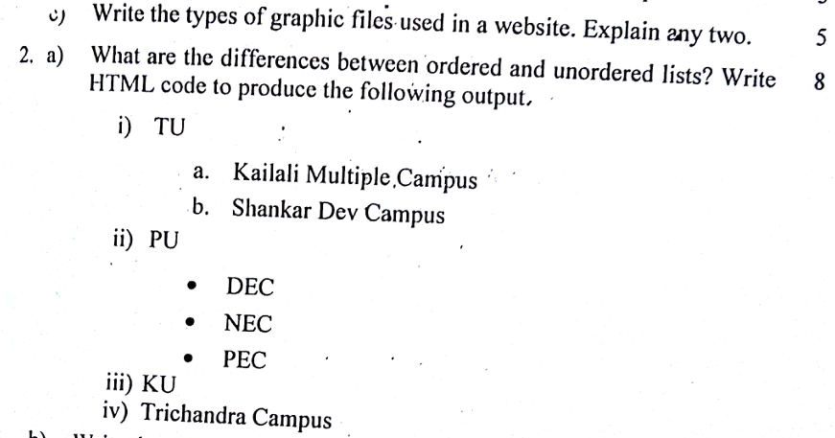

Slide 89
2.5 HTML Tables
The HTML tables allow web authors to arrange data like text, images, links, other tables, etc. into rows and columns of cells.
The HTML tables are created using the <table> tag in which the
<tr> tag is used to create table rows and
<td> tag is used to create data cells.
The elements under <td> are regular and left aligned by default.

Slide 90
Example:
<table border = "1">
<tr>
<td>Row 1, Column 1</td>
<td>Row 1, Column 2</td>
</tr>
<tr>
<td>Row 2, Column 1</td>
<td>Row 2, Column 2</td>
</tr>
</table>

Slide 91
Table Heading
▶ Table heading can be defined using tag <th>
▶ This tag is used to represent <td>
▶ Normally, <th> are placed in our top row however we can use <th> element in any row.

Slide 92
Table Heading
<table border = "1">
<tr>
<th>Name</th>
<th>Salary</th>
</tr>
<tr>
<td>Ramesh Raman</td>
<td>5000</td>
</tr>
<tr>
<td>Shabbir Hussein</td>
<td>7000</td>
</tr>
</table>

Slide 93
Cellpadding and Cellspacing Attributes
There are two attributes called cellpadding and cellspacing which we will use to adjust the white space in your table cells.
The cellspacing attribute defines space between table cells, while
cellpadding represents the distance between cell borders and the content within a cell.

Slide 94
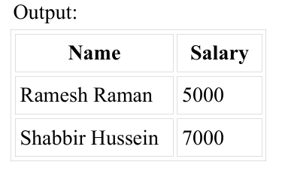
Example:
<table border = "1" cellpadding = "5" cellspacing = "5">
<tr>
<th>Name</th>
<th>Salary</th>
</tr>
<tr>
<td>Ramesh Raman</td>
<td>5000</td>
</tr>
<tr>
<td>Shabbir Hussein</td>
<td>7000</td>
</tr>
</table>

Slide 95
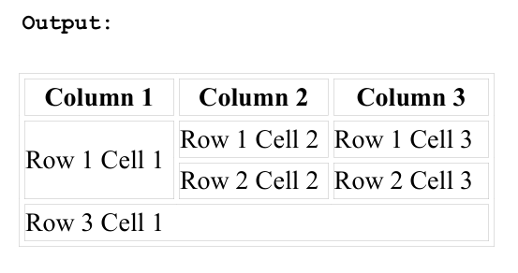
Colspan and Rowspan Attributes
Colspan => to merge two or more columns into a single column
Rowspan => to merge two or more rows
<table border = "1">
<tr>
<th>Column 1</th>
<th>Column 2</th>
<th>Column 3</th>
</tr>
<tr>
<td rowspan = "2">Row 1 Cell 1</td>
<td>Row 1 Cell 2</td>
<td>Row 1 Cell 3</td>
</tr>
<tr>
<td>Row 2 Cell 2</td>
<td>Row 2 Cell 3</td>
</tr>
<tr>
<td colspan = "3">Row 3 Cell 1</td>
</tr>
</table>

Slide 96
Tables Backgrounds
We can set table background using one of the following two ways
bgcolor attribute − We can set background color for whole table or just for one cell.
background attribute −We can set background image for whole table or just for one cell.
NOTE:
We can also set border color also using bordercolor attribute.
The bgcolor, background, and bordercolor attributes deprecated in HTML5. Do not use these attributes.

Slide 97
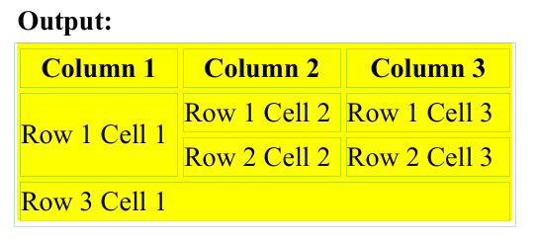
Example of bordercolor and bgcolor attributes
<table border = "1" bordercolor = "green" bgcolor = "yellow">
<tr>
<th>Column 1</th>
<th>Column 2</th>
<th>Column 3</th>
</tr>
<tr>
<td rowspan = "2">Row 1 Cell 1</td>
<td>Row 1 Cell 2</td>
<td>Row 1 Cell 3</td>
</tr>
<tr>
<td>Row 2 Cell 2</td>
<td>Row 2 Cell 3</td>
</tr>
<tr>
<td colspan = "3">Row 3 Cell 1</td>
</tr>
</table>

Slide 98
Example of background attribute
Here, an image available in /images directory.
<table border = "1" bordercolor = "green" background = "/images/test.png">
<tr>
<th>Column 1</th>
<th>Column 2</th>
<th>Column 3</th>
</tr>
<tr>
<td rowspan = "2">Row 1 Cell 1</td>
<td>Row 1 Cell 2</td><td>Row 1 Cell 3</td>
</tr>
<tr>
<td>Row 2 Cell 2</td>
<td>Row 2 Cell 3</td>
</tr>
<tr>
<td colspan = "3">Row 3 Cell 1</td>
</tr>
</table>

Slide 99
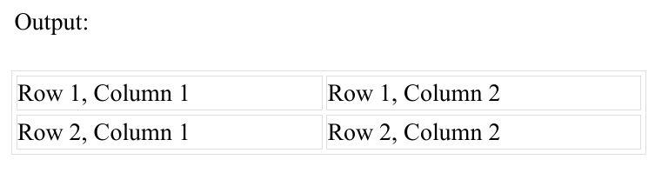
Table Height and Width
You can set a table width and height using width and height attributes.
You can specify table width or height in terms of pixels or in terms of percentage of available screen area.
<table border = "1" width = "400" height = "150">
<tr>
<td>Row 1, Column 1</td>
<td>Row 1, Column 2</td>
</tr>
<tr>
<td>Row 2, Column 1</td>
<td>Row 2, Column 2</td>
</tr>
</table>

Slide 100
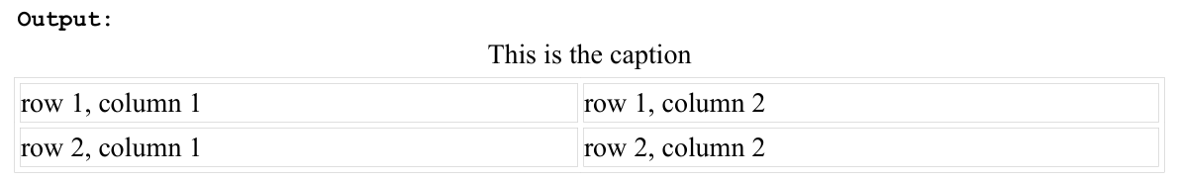
Table Caption
The caption tag will serve as a title or explanation for the table and it shows up at the top of the table.
This tag is deprecated in newer version of HTML/XHTML.
<table border = "1" width = "100%">
<caption>This is the caption</caption>
<tr>
<td>row 1, column 1</td><td>row 1, columnn 2</td>
</tr>
<tr>
<td>row 2, column 1</td><td>row 2, columnn 2</td>
</tr>
</table>

Slide 101
Grouping Sections of a Table
The three elements for separating the head, body, and foot of a table are −
<thead> − to create a separate table header.
<tbody> − to indicate the main body of the table.
<tfoot> − to create a separate table footer.
A table may contain several <tbody> elements to indicate different pages or groups of data.
But it is notable that <thead> and <tfoot> tags should appear before <tbody>

Slide 102
Example:
<table border = "1" width = "100%">
<thead>
<tr>
<td colspan = "4">This is the head of the table</td>
</tr>
</thead>
<tfoot>
<tr>
<td colspan = "4">This is the foot of the table</td>
</tr>
</tfoot>
<tbody>
<tr>
<td>Cell 1</td>
<td>Cell 2</td>
<td>Cell 3</td>
<td>Cell 4</td>
</tr>
</tbody>
</table>

Slide 103
Nested Tables
We can use one table inside another table.
Not only tables we can use almost all the tags inside table data tag <td>.
<table border = "1" width = "100%">
<tr>
<td>
<table border = "1" width = "100%">
<tr>
<th>Name</th>
<th>Salary</th>
</tr>
<tr>
<td>Ramesh Raman</td>
<td>5000</td>
</tr>
<tr>
<td>Shabbir Hussein</td>
<td>7000</td>
</tr>
</table>
</td>
<td>This is another cell</td>
</tr>
</table>

Slide 104
Accessible Tables
Accessible tables are designed with screen readers and assistive technologies in mind to ensure all users can understand the table’s structure and data.
Notes:
Assistive technologies (AT) are tools, devices, software, and services designed to improve the functional capabilities of individuals with disabilities, enabling them to perform tasks that might otherwise be challenging or impossible. These technologies help individuals interact with digital content, navigate physical spaces, and communicate more effectively.
key types and examples of assistive technologies:
1. Screen Readers
Description: Screen readers convert text and other elements on a screen into synthesized speech, enabling visually impaired users to interact with digital content.
Examples:
JAWS (Job Access With Speech): A widely-used screen reader for Windows.
NVDA (NonVisual Desktop Access): A free, open-source screen reader for Windows.
VoiceOver: Built-in screen reader for macOS and iOS.
TalkBack: The built-in screen reader on Android devices.
2. Speech Recognition Software
Description: Speech recognition software allows users to control devices, input text, and navigate interfaces using voice commands.
Examples:
Dragon NaturallySpeaking: A leading voice-recognition software for dictation and command-and-control tasks.
Google Assistant and Siri: Voice-activated assistants that allow users to control their smartphones hands-free.
Windows Speech Recognition: Built-in voice control and dictation tool on Windows.

Slide 105
Key Techniques for Accessible Tables:
<caption>: Provides a summary or title for the table, describing its purpose.
<thead>, <tbody>, and <tfoot>: Helps screen readers identify different sections of the table.
scope Attribute:
Used in <th> elements to specify whether the header applies to a row, column, or group of rows/columns.
It helps users understand header relationships.
<table border="1">
<caption>Student Information</caption>
...
</table>

Slide 106

Key Techniques for Accessible Tables:
Example-1 of scope Attribute:
<table border="1">
<tr>
<th scope="col">Name</th>
<th scope="col">Age</th>
<th scope="col">City</th>
</tr>
<tr>
<td>John</td>
<td>25</td>
<td>New York</td>
</tr>
</table>
Output:

Slide 107
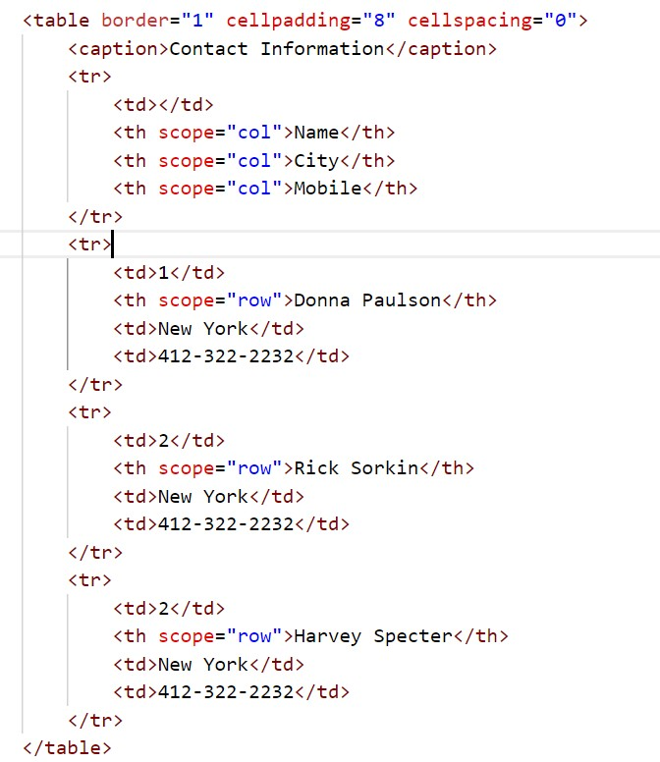
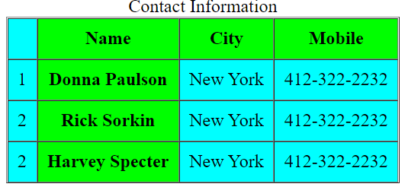
Example-2 of scope Attribute:

Slide 108
Key Techniques for Accessible Tables
headers Attribute:
Used in <td> elements to link data cells with header cells, especially for complex tables.
The id attribute can be applied to <th> cells to provide a unique reference.
Example:
<table border="1">
<tr>
<th id="name">Name</th>
<th id="age">Age</th>
<th id="city">City</th>
</tr>
<tr>
<td headers="name">John</td>
<td headers="age">25</td>
<td headers="city">New York</td>
</tr>
</table>
unique
id attribute can be applied to <th> cells
Used in <td> elements to link data cells with header cells

Slide 109
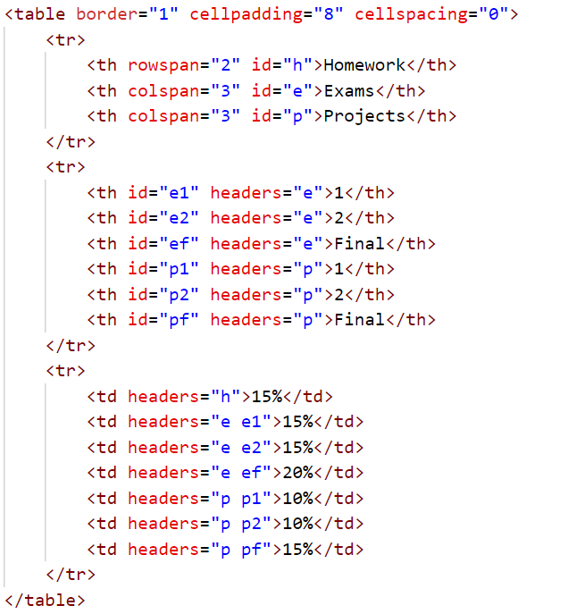
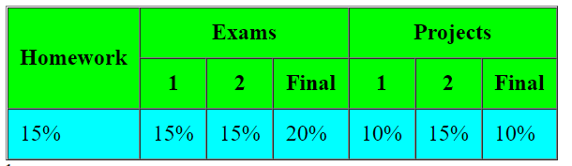
Example of Table Accessibility

Slide 110
How to Linearize Tables
Linearization is the process of making tables readable in a logical order for users of assistive technologies.
This involves simplifying complex table structures, such as
reducing nested tables or
using <thead>, <tbody>, <tfoot>, and
scope/headers attributes,
so that screen readers can convey table content in a meaningful, linear flow.

Slide 111
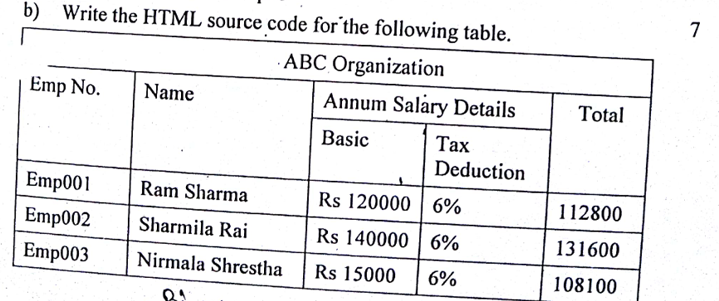

Slide 112
2.6 HTML Form
▶ Required when we want to collect some data from the site visitor.
▶ Eg, registration, survey
▶ A form will take input from user and will post it to a back-end application such as CGI, ASP Script or PHP Script
▶ The backend application will perform required processing on the passed data based on defined business logic inside the application.
▶ <form> tag is used to create an HTML form.
<form action = "Script URL" method = "GET|POST">
form elements like input, textarea etc.
</form>

Slide 113
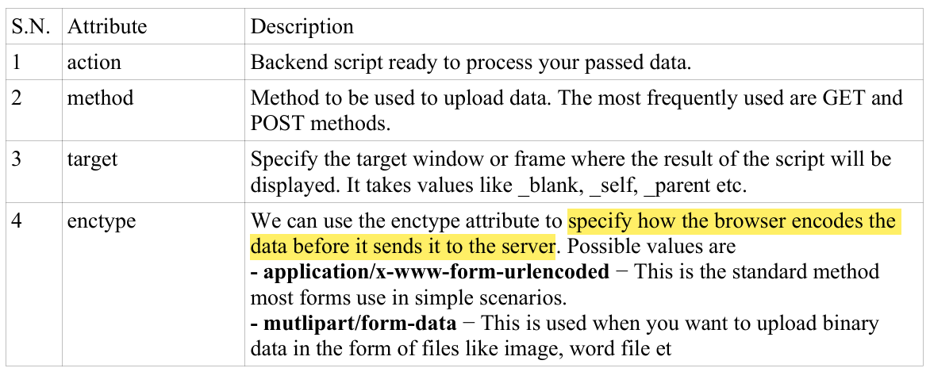
Form Attributes

Slide 114
Day 8

Slide 115
HTML Form Controls
There are different types of form controls that you can use to collect data using HTML form −
Text Input Controls
Checkboxes Controls
Radio Box Controls
Select Box Controls
File Select boxes
Hidden Controls
Button Controls

Slide 116
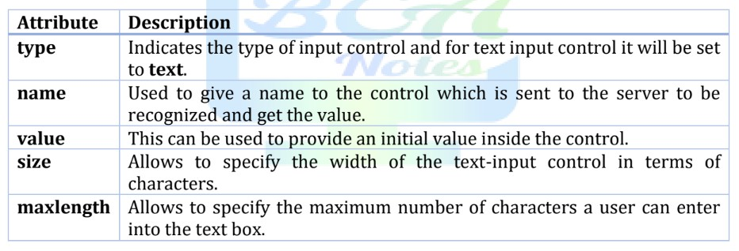
Text Input Controls
There are three types of text input used in forms
Single-line text input controls −
This control is used for items that require only one line of user input, such as search boxes or names.
They are created using HTML <input> tag.
Example:
list of attributes for <input>
<form >
User ID : <input type = "text" name = "user_id" value="" size="10" maxlength="30"/> <br>
User name : <input type = "text" name = "user_name" value="" size="30" maxlength="50"/>
</form>

Slide 117
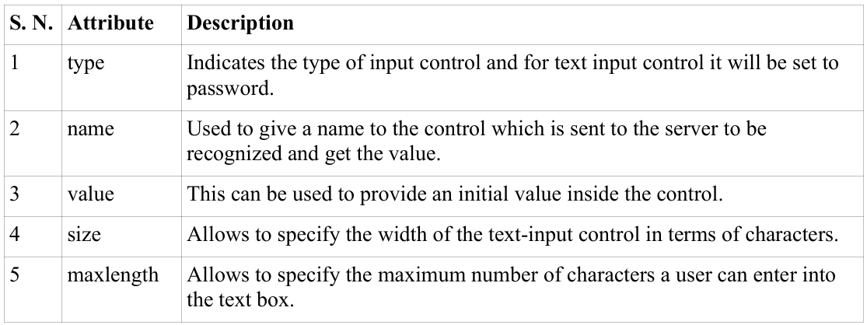
Text Input Controls
There are three types of text input used in forms
Password input controls
This is also a single-line text input but it masks the character as soon as a user enters it.
They are also created using HTML <input> tag.
Example:
list of attributes for <input>
<form >
User ID : <input type = "text" name = "user_id" value="" size="10" maxlength="30"/> <br>
Password: <input type = "password" name = "password" />
</form>

Slide 118
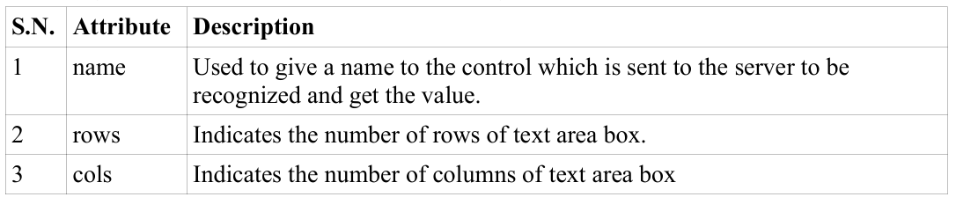
Text Input Controls
There are three types of text input used in forms
Multi-line text input controls
This is used when the user is required to give details that may be longer than a single sentence.
Multi-line input controls are created using HTML <textarea> tag.
Example:
list of attributes for <input>
<form>
Description : <br />
<textarea rows = "5" cols = "50" name = "description" placeholder="Enter description here..."></textarea>
</form>

Slide 119
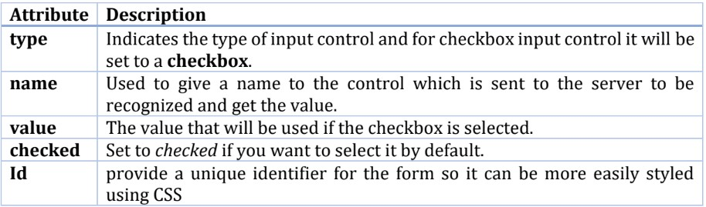
2. Checkboxes Controls
Checkboxes are used when more than one option is required to be selected.
They are also created using HTML <input> tag but type attribute is set to checkbox..
Example
list of attributes for <checkbox> tag.
<form>
<input type = "checkbox" name = "maths" value = "on"> Maths
<input type = "checkbox" name = "physics" value = "on" checked> Physics
</form>

Slide 120
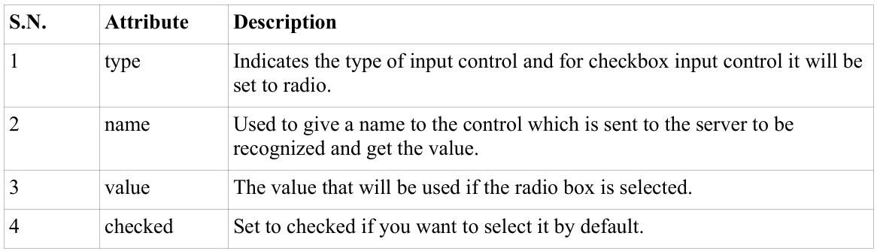
3. Radio Box Controls
Radio buttons are used when out of many options, just one option is required to be selected.
They are also created using HTML <input> tag but type attribute is set to radio.
Example
list of attributes for radio button
<form>
<input type = "radio" name = "subject" value = "maths"> Maths
<input type = "radio" name = "subject" value = "physics" checked> Physics
</form>

Slide 121
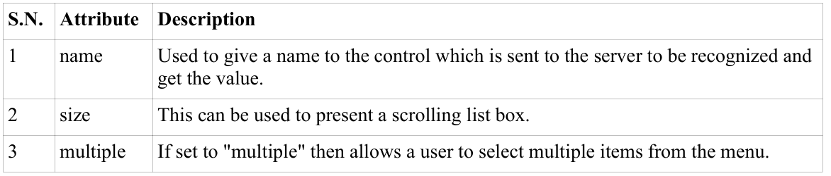
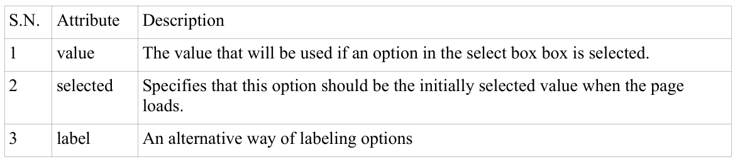
4. Select Box Controls
A select box, also called drop down box
which provides option to list down various options in the form of drop down list,
from where a user can select one or more options.
Example:
Attributes
<form>
<select name = "dropdown" size="10" multiple>
<option value = "Maths" selected>Maths</option>
<option value = "Physics">Physics</option>
<option value = "Engish">English</option>
<option value = "Calculus">Calculus</option>
</select>
</form>
attributes of <select> tag | attributes of <option> tag

Slide 122
6. Hidden Controls
A hidden field lets web developers include data that cannot be seen or modified by users when a form is submitted.
Hidden field often stores what database record that needs to be updated when the form is submitted.
NOTE:
While the value is not displayed to the user in the page's content, it is visible (and can be edited) using any browser's developer tools or "View Source" functionality.
Do not use hidden inputs as a form of security!
Example
<form>
<p>This is page 10</p>
<input type = "hidden" name = "pagename" value = "10" />
<input type = "submit" name = "submit" value = "Submit" />
</form>
Notes:
Common use cases for hidden fields:
Storing data between requests: When users navigate between pages, you might want to preserve some state or data (such as a session ID, user ID, or transaction ID). Hidden fields allow you to store this information and send it to the server when the form is submitted.
Pass non-visible data to the server: You can store extra information that your application needs (like timestamps, references, flags, or server-side generated data) without showing it on the page.
Retain data across forms: If a user needs to go through multiple steps in a process (e.g., a multi-step form or checkout process), hidden fields can carry data between steps without the user needing to manually enter the same information multiple times.
Form validation: In some cases, you might use hidden fields to indicate whether a form was validated on the server side, or to store a token for CSRF protection.
Things to keep in mind:
Hidden fields can be manipulated by users if they inspect the page source or use developer tools. Therefore, they should not be used to store sensitive data like passwords or private information. For sensitive data, you should use server-side mechanisms (e.g., sessions, tokens).
They don't provide security on their own, so don't rely solely on hidden fields for security-critical operations.

Slide 123
7. Buttons Control
There are various ways in HTML to create clickable buttons.
You can also create a clickable button using <input> tag by setting its type attribute to button.
Example
<form>
<input type = "submit" name = "submit" value = "Submit" />
<input type = "reset" name = "reset" value = "Reset" />
<input type = "button" name = "ok" value = "OK" />
<input type = "image" name = "imagebutton" src = "button.png" />
</form>

Slide 124
f. Button Control
▶ type=“submit”
▶ Creates a button that automatically submits a form
▶ type=“reset”
▶ Creates a button that automatically resets form controls to their initial values
▶ type=“button”
▶ Creates a button that is used to trigger a client-side script when user clicks that button
▶ type=“image”
▶ Creates a clickable button but we can use an image as the background

Slide 125
Fieldset and Legend
By using fieldset and legend tag we can make our form more easier to understand for the users.
Fieldset
The <fieldset> tag is used to group related elements in a form.
The <fieldset> tag draws a box around the related elements.
Legend
The <legend> tag defines a caption for the <fieldset> element.

Slide 126
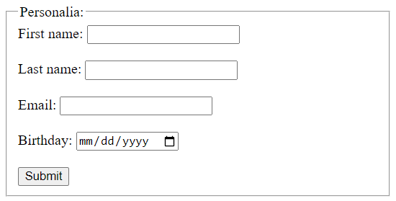
Example:
<form action="/action_page.php">
<fieldset>
<legend>Personalia:</legend>
<label for="fname">First name:</label>
<input type="text" id="fname" name="fname"><br><br>
<label for="lname">Last name:</label>
<input type="text" id="lname" name="lname"><br><br>
<label for="email">Email:</label>
<input type="email" id="email" name="email"><br><br>
<label for="birthday">Birthday:</label>
<input type="date" id="birthday" name="birthday"><br><br>
<input type="submit" value="Submit">
</fieldset>
</form>
Output:

Slide 127
Focus
The focus() method gives focus to an element (if it can be focused). (We will further study it in next chapter (javascript)).
AccessKey Property
The accesskey attribute specifies a shortcut key to activate/focus an element.
Example:
<a id="myid" accesskey="g" href="https://www.google.com/">Google</a>

Slide 128
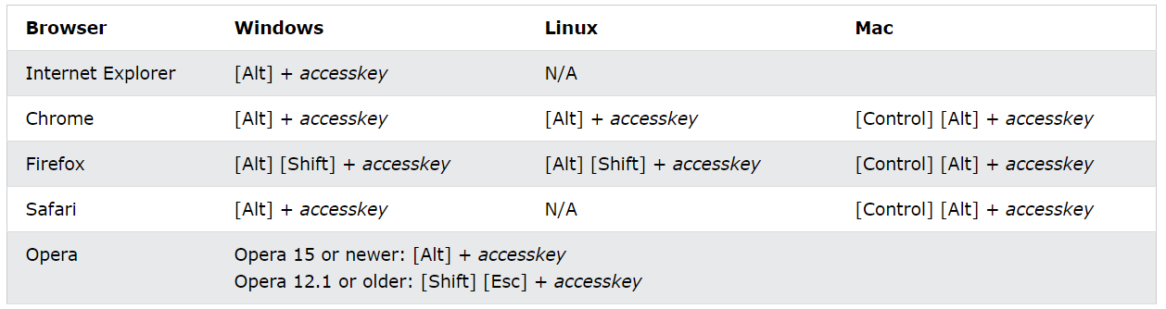
The way of accessing the shortcut key is varying in different browsers:

Slide 129
Tabindex
This attribute is used to specify the tab order of an element.
It is used when the tab button is used for navigating.
It supports all HTML element.
Syntax:
<element tabindex = "number">
Example:
<div>
first Name : <input type = "text" name = "fname" value="" tabindex="1"/><br>
Last Name : <input type ="text" name ="lname" value="" tabindex="2"/><br>
User ID : <input type ="text" name="user_id" value="" tabindex="5"/><br>
Password: <input type = "password" name = "password" tabindex="4" /><br>
</div>
Notes:
Keyboard ko Tab button press gardaa next kun maa jaane ta bhanera order set garna laai tabindex raakhinxa.

Slide 130
Disabled and Read Only Controls
Disabled Control
The disabled attribute is a boolean attribute.
When present, it specifies that the element should be disabled.
A disabled element is unusable.
The disabled attribute can be used on the following elements:
<button>, <fieldset>, <input>, <optgroup>, <option>, <select>, <textarea>
Example:
<form action="/action_page.php">
First name: <input type="text" name="fname"><br>
Last name: <input type="text" name="lname" disabled><br>
<input type="submit" value="Submit">
</form>
Disabled elements in a form will not be submitted!

Slide 131
Read Only Control
The readonly attribute is a boolean attribute. When present, it specifies that an element/field is read only.
A read-only input field cannot be modified (however, a user can tab to it, highlight it, and copy the text from it).
The readOnly property makes the element non-editable but it can still be focused by tab or click.
If there is a default value inside a read-only element then it is sent to a server on submit.
Example:
<input type="text" name="lname" value="Khojwar" readonly>
Notes:
A form will still submit an input field that is readonly, but will not submit an input field that is disabled!

Slide 132
Sending form data to the server
There are two ways the browser client can send information to the webserver
The GET Method
The POST Method
URL encoding
Before the browser sends the information, it encodes it using a scheme called URL encoding.
In this scheme, name/value pairs are joined with equal signs and different pairs are separated by the ampersand(&).
Eg. name1=value1&name2=value2&name3=value3
Spaces are replaced with + character
Non-alphanumeric characters are replaced with hexadecimal values

Slide 133
The GET Method
The GET method sends the encoded user information appended to the page request.
The page and the encoded information are separated by the ? Character.
http://www.test.com/index.htm?name1=value1&name2=value2
The GET method produces a long string that appears in your server logs, in the browser's Location: box.
The GET method is restricted to send upto 1024 characters only.
Never use GET method if you have password or other sensitive information to be sent to the server.
GET can't be used to send binary data, like images or word documents, to the server.
The data sent by GET method can be accessed using QUERY_STRING environment variable.
The PHP provides $_GET associative array to access all the sent information using GET method.

Slide 134
The GET Method
<?php
if( $_GET["name"] || $_GET["age"] ) {
echo "Welcome ". $_GET['name']. "<br />";
}
echo "You are ". $_GET['age']. " years old.";
exit();
?>
<html>
<body>
<form action = "<?php $_PHP_SELF ?>" method = "GET">
Name: <input type = "text" name = "name" />
Age: <input type = "text" name = "age" />
<input type = "submit" />
</form>
</body>
</html>

Slide 135
The Post Method
The POST method transfers information via HTTP headers.
The information is encoded as described in case of GET method and put into a header called QUERY_STRING.
The POST method does not have any restriction on data size to be sent.
The POST method can be used to send ASCII as well as binary data.
The data sent by POST method goes through HTTP header so security depends on HTTP protocol. By using Secure HTTP you can make sure that your information is secure.
The PHP provides $_POST associative array to access all the sent information using POST method.

Slide 136
The Post Method
<?php
if( $_POST["name"] || $_POST["age"] ) {
echo "Welcome ". $_POST['name']. "<br />";
echo "You are ". $_POST['age']. " years old.";
exit();
}
?>
<html>
<body>
<form action = "<?php $_PHP_SELF ?>" method = "POST">
Name: <input type = "text" name = "name" />
Age: <input type = "text" name = "age" />
<input type = "submit" />
</form>
</body>
</html>

Slide 137
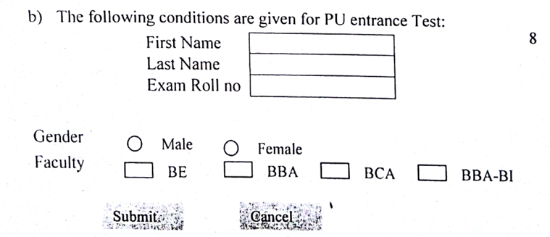

Slide 138
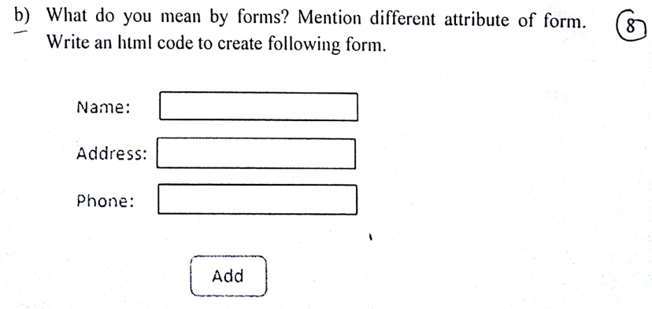

Slide 139
Day 9

Slide 140
2.7 Frames
HTML frames are used to divide our browser window into multiple sections where each section can load a separate HTML document.
A collection of frames in the browser window is known as a frameset.
The window is divided into frames in a similar way the tables are organized: into rows and columns.

Slide 141
Advantages of frames
it allows the user to view multiple documents within a single Web page.
It is possible to load pages from different servers in a single frameset.
Although there are very few advantages of frames, its not recommended to use frames in modern websites.

Slide 142
Disadvantages of Frames
There are few drawbacks with using frames, so it's never recommended to use frames in your webpages −
Some smaller devices cannot cope with frames often because their screen is not big enough to be divided up.
Sometimes your page will be displayed differently on different computers due to different screen resolution.
The browser's back button might not work as the user hopes.
There are still few browsers that do not support frame technology.
Notes:
Cope = सामना

Slide 143
Creating Frames
To use frames on a page we use <frameset> tag instead of <body> tag.
The <frameset> tag defines, how to divide the window into frames.
The rows attribute of <frameset> tag defines horizontal frames and cols attribute defines vertical frames.
Each frame is indicated by <frame> tag and it defines which HTML document shall open into the frame.

Slide 144
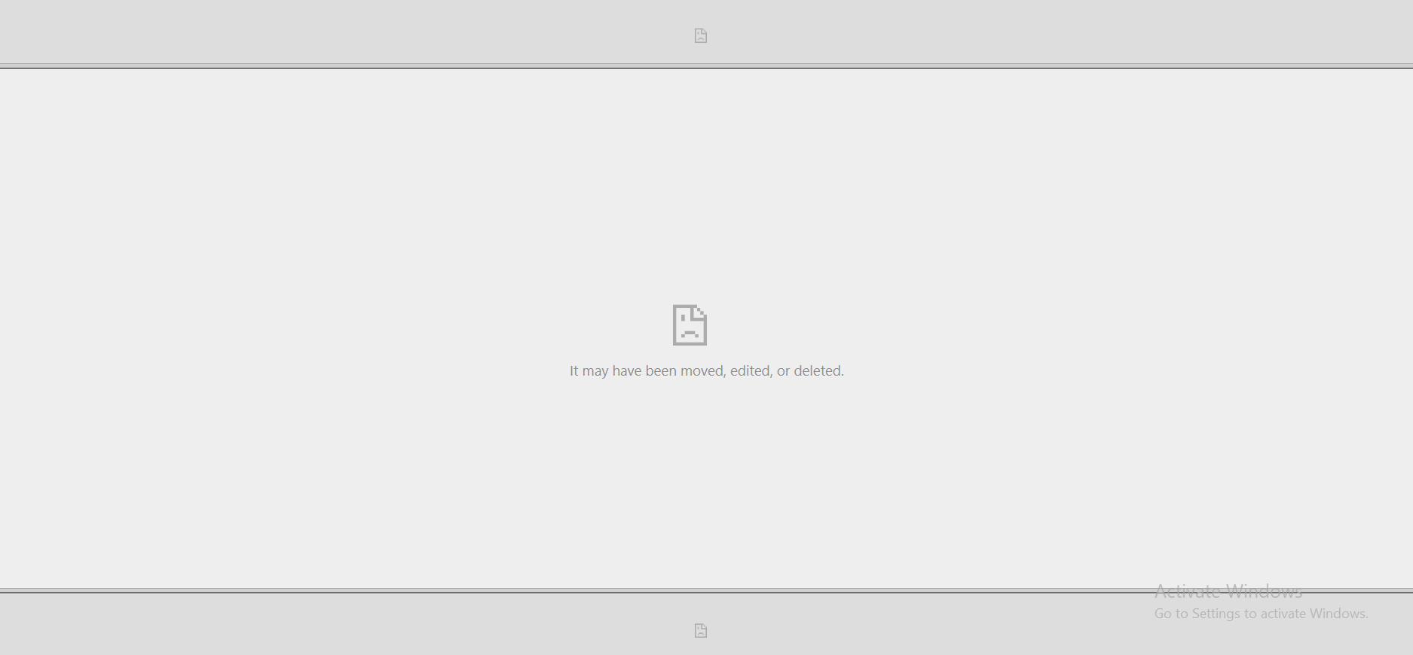
<!DOCTYPE html>
<html>
<head>
<title>HTML Frames</title>
</head>
<frameset rows = "10%,80%,10%">
<frame name = "top" src = "/html/top_frame.htm" />
<frame name = "main" src = "/html/main_frame.htm" />
<frame name = "bottom" src = "/html/bottom_frame.htm" />
<noframes>
<body>Your browser does not support frames.</body>
</noframes>
</frameset>
</html>
Output:

Slide 145

<!DOCTYPE html>
<html>
<head>
<title>HTML Frames</title>
</head>
<frameset cols = "25%,50%,25%">
<frame name = "top" src = "form 2.6.14-readonly.html" />
<frame name = "main" src = "form 2.6.13-disabled.html" />
<frame name = "bottom" src = "form 2.6.4-checkbox.html" />
<noframes>
<body>Your browser does not support frames.</body>
</noframes>
</frameset>
</html>
Output:

Slide 146
<frameset> Tag Attributes
Attribute | Description
Cols | Specifies how many columns are contained in the frameset and the size of each column. Absolute values in pixels cols=“100,200,500” A percentage of the browser window cols = “10%,80%,10%’ Using wildcard symbol cols=“10*,*”, cols=“*,10%” As relative widths of the browser window. cols=“3*,2*,1*”
Rows | This attribute works just like the cols attribute and takes the same values, but it is used to specify the rows in the frameset. eg. rows=“10%,90%”

Slide 147
<frameset> Tag Attributes
Attribute | Description
Border | This attribute specifies the width of the border of each frame in pixels. - A value of zero means no boder
Frameborder | This attribute specifies whether a 3-Dimensional border should be displayed between frames. - values -> 1(yes) or 0(no)
Framespacing | This attribute specifies the amount of space between frames in a frameset. This can take any integer value.

Slide 148
<frame> Tag Attributes
Attribute | Description
src | This attribute is used to give the file name that should be loaded in the frame.
name | This attribute allows us to give a name to the frame. It is used to indicate which frame a document should be loaded into. This is especially important when we want to create links in one frame that load pages into another frame
frameborder | This attribute specifies whether or not the borders of that frame are shown.
marginwidth | This attribute allows you to specify the width of the space between the left and right of the frame’s border and frame’ content

Slide 149
<frame> Tag Attributes
Attribute | Description
Marginheight | This attribute allows you to specify the height of the space between the top and bottom of the frame’s border and its contents.
Noresize | By default, we can resize any frame by clicking and dragging on the borders of a frame
Scrolling | This attribute controls the appearance of the scrollbars that appear on the frame. It takes values either “yes”, ”no” or “auto”.
Longdesc | This attribute allows you to provide a link to another page containing a long description of the contents of the frame.

Slide 150
Browser Support for Frames
If a user is using any old browser or any browser, which does not support frames then <noframes> element should be displayed to the user.
So you must place a <body> element inside the <noframes> element
because the <frameset> element is supposed to replace the <body> element,
but if a browser does not understand <frameset> element then it should understand what is inside the <body> element which is contained in a <noframes> element.
You can put some nice message for your user having old browsers.
For example, Sorry!! your browser does not support frames. as shown in the below example.
<noframes>
<body>Your browser does not support frames.</body>
</noframes>

Slide 151
Nesting of Frame sets
Framesets may be nested to any level.
In the following example,
the outer FRAMESET divides the available space into three equal rows.
The inner FRAMESET then divides the second area into three columns of unequal width.
<FRAMESET rows="33%, 33%, 34%">
<FRAMESET cols="100%">
...contents of first frame, and a column, it only contains one column
</FRAMESET>
<FRAMESET cols="*,*,*">
...contents of second frame, first column...
...contents of second frame, second column...
...contents of second frame, third column...
</FRAMESET>
<FRAMESET cols="100%">
...contents of third frame, and a column, it only contains one column
</FRAMESET>
</FRAMESET>

Slide 152
Iframe
An HTML iframe is used to display a web page within a web page.
The HTML <iframe> tag specifies an inline frame.
An inline frame is used to embed another document within the current HTML document.
Syntax
<iframe src="url" title="description" ></iframe>
Example:
<iframe src="https://www.pu.edu.np" height="200" width="300" title="Pokhara University"></iframe>

Slide 153
<frame> Tag Attributes
Attribute | Description
src | This attribute is used to give the file name that should be loaded in the frame.
name | This attribute allows us to give a name to the frame. It is used to indicate which frame a document should be loaded into. This is especially important when we want to create links in one frame that load pages into another frame
frameborder | This attribute specifies whether or not the borders of that frame are shown.
marginwidth | This attribute allows you to specify the width of the space between the left and right of the frame’s border and frame’ content

Slide 154
<frame> Tag Attributes
Attribute | Description
Marginheight | This attribute allows you to specify the height of the space between the top and bottom of the frame’s border and its contents.
Noresize | By default, we can resize any frame by clicking and dragging on the borders of a frame
Scrolling | This attribute controls the appearance of the scrollbars that appear on the frame. It takes values either “yes”, ”no” or “auto”.
Longdesc | This attribute allows you to provide a link to another page containing a long description of the contents of the frame.

Slide 155
2.8 Exploring new elements of HTML5
HTML5 is the latest and most enhanced version of HTML.
HTML is not a programming language, but rather a markup language.
HTML5 is the next major revision of the HTML standard superseding HTML 4.01.
HTML5 is a cooperation between the World Wide Web Consortium (W3C) and the Web Hypertext Application Technology Working Group (WHATWG)

Slide 156
HTML5 – New Tags
Tag | Description
<article> | Represents an independent piece of content of a document, such as a blog entry or newspaper article.
<aside> | Represents a piece of content that is only slightly related to the rest of the page
<audio> | Defines an audio file.
<canvas> | This is used for rendering dynamic bitmap graphics on the fly, such as graphs or games.
<command> | Represents a command the user can invoke
<datalist> | Together with a new list attribute for input can be used to make combobox

Slide 157
HTML5 – New Tags
Tag | Description
<details> | Represents additional information or controls which the user can obtain or Demand
<embed> | Defines external interactive content or plugin
<figure> | Represents a piece of self-obtained flow content, typically referenced as a single unit from the main flow of the document.
<footer> | Represents a footer for a section and can obtain information about the author, copyright information et cetera.
<header> | Represents a group of introductory or navigational aids
<hgroup> | Represents the header of a section.

Slide 158
HTML5 – New Tags
Tag | Description
<keygen> | Represents a control for key pair generation
<mark> | Represents a run of text in one document marked or highlighted for reference purposes, due to its relevance in another context
<meter> | Represents a measurement, such as disk usage
<nav> | Represents a section of the document intended for navigation
<output> | Represents some type of output, such as form a calculation done through scripting
<progress> | Represents a completion of a task, such as downloading or when performing a series of expensive operations

Slide 159
HTML5 – New Tags
Tag | Description
<ruby> | Together with <rt> and <rp> allow for marking up ruby annotations
<section> | Represents a generic document or application section
<time> | Represents a date and/or time
<video> | Defines a video file.
<wbr> | Represents a line break opportunity

Slide 160
New Types of <input> Tag:
Tag | Description
Color | Color selector, which could be represented by a wheel or swatch picker
Date | Selector for calendar date
Datetime-local | Date and time display, with no setting or indication for time zones
Datetime | Full date and time display, including a time zone
Email | The input type should be email
Month | Selector for a month within a given year

Slide 161
New Types of <input> Tag:
Tag | Description
Number | A field contained a numeric value only
Range | Numeric selector within a range of values, typically visualized as a slider.
Search | Term to supply to a search engine. For example, the search bar atop a browser.
Tel | The input type should be a telephone number
Time | Time indicator and selector, with no time zone information
URL | The input type should be the URL type
Week | Selector for a week within a given year

Slide 162
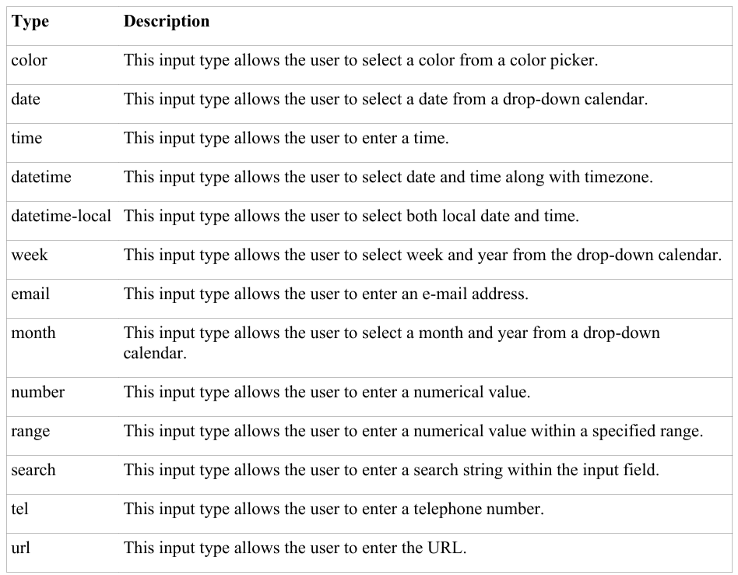
2.8.1 New Types <input> types
There are some added input types in HTML5.

Slide 163
<keygen> Tag
The <keygen> tag in HTML is used to specify a key-pair generator field in a form.
The purpose of <keygen> element is to provide a secure way to authenticate users.
When a form is submitted then two keys are generated, private key and public key.
The private key is stored locally, and
the public key is sent to the server. The public key is used to generate a client certificate to authenticate the user for the future.
Note: <keygen> tag is not supported in html5

Slide 164
Example:
<form action="/form/submit" method="get">
<keygen name="rsaPublicKey" keytype="RSA">
User’s name: <input type="text" name="usr_name">
<input type="submit">
</form>

Slide 165
<keygen> Tag
Syntax:
<keygen name = "name">
Example:
<form>
Username: <input type="text" name="uname"> <br><br>
Encryption: <keygen name="secure">
<input type="submit">
</form>

Slide 166
<progress> Tag
The <progress> tag represents the completion progress of a task.
Progress must have both start tag and an end tag.
We can use the <progress> tag in conjunction with JavaScript to display the progress of a task.
Attributes
max - Specifies how much work the task requires in total. Default value is 1
value - Specifies how much of the task has been completed
Example:
<label for="file">Downloading progress:</label>
<progress id="file" value="32" max="100"> 32% </progress>

Slide 167

<meter> Tag
The <meter> tag defines a scalar measurement within a known range, or a fractional value. This is also known as a gauge.
Examples: Disk usage, the relevance of a query result, etc.
Example:
Note: The <meter> tag should not be used to indicate progress (as in a progress bar). For progress bars, use the <progress> tag.
<label for="disk_c">Disk usage C:</label>
<meter id="disk_c" value="2" min="0" max="10">2 out of 10</meter><br>
<label for="disk_d">Disk usage D:</label>
<meter id="disk_d" value="0.6">60%</meter>
Output:

Slide 168

<menu> Tag
The <menu> tag defines an unordered list of content.
Use the <menu> tag together with the <li> tag to create menu items.
Example:
Note: <menu> tag is an alternative to the <ul> tag and browsers will treat these two lists equally.
<menu>
<li>Coffee</li>
<li>Tea</li>
<li>Milk</li>
</menu>
Output:

Slide 169
<header> Tag
The <header> element represents a container for introductory content or a set of navigational links.
A <header> element typically contains:
one or more heading elements (<h1> - <h6>)
logo or icon
authorship information
Example:
Note: You can have several <header> elements in one HTML document. However, <header> cannot be placed within a <footer>, <address> or another <header> element.
<header>
<h1>Main page heading here</h1>
<p>Posted by John Doe</p>
</header>

Slide 170
<footer> Tag
The <footer> tag defines a footer for a document or section.
A <footer> element typically contains:
authorship information
copyright information
contact information
sitemap
back to top links
related documents
You can have several <footer> elements in one document.
Example:
<footer>
<p>Author: Pradip Bhattarai<br>
<a href="mailto:pradip@ncit.edu.np">mail me</a></p>
</footer>

Slide 171
Spell Check Attribute
The spellcheck attribute specifies whether the element is to have its spelling and grammar checked or not.
If we set spellcheck to true, the the user entered wrong word will be highlighted with a red underline.
The following can be spellchecked:
Text values in input elements (not password)
Text in <textarea> elements
Text in editable elements
Example:
<form>
<p><input type="text" spellcheck="true"></p>
<p><textarea spellcheck="true"></textarea></p>
<button type="reset">Reset</button>
</form>

Slide 172
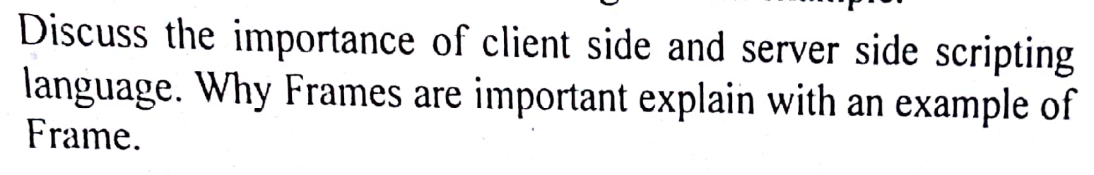

Slide 173
Thank You!!!

